Slide 1
Leveraging User Context Prediction for Adaptive Memory Management in AI-Heavy Mobile Environments
Capstone Project — Project-I Review
Presented By:
[Student Name 1] — [Roll No.]
[Student Name 2] — [Roll No.]
[Student Name 3] — [Roll No.]
Guide: [Prof. Name], [Department]
[University Name], [City]
August 2026
1

Slide 2
1. Problem Statement
Mobile devices with 4–8 GB RAM run concurrent AI workloads (camera AI, translation, on-device LLMs) alongside user applications. Current memory management is reactive:
LRU-based process cache: evicts least recently used app; ignores temporal patterns and variable reload cost
Low Memory Killer (LMKD): kills processes only after pressure is critical; no predictive capability
Problem | Impact
App cold-start | 1–3 sec latency per evicted app; 3–6 sec for AI apps
Memory thrashing | Repeated evict → reload → evict cycles
AI model cache eviction | Camera AI, LLM weights evicted; expensive to reload
Battery drain | 8–15% additional consumption from redundant I/O
The proposed approach uses ML-based prediction to anticipate which app will be needed next and retain it in cache proactively.
2

Slide 3
2. Domain Background
Mobile Memory Landscape (2024–2026)
Average user: 40–80 installed apps, 9–10 active daily, ~65 app switches/day
Median Android device: 6 GB RAM; on-device AI models consume 300 MB – 4 GB each
Mobile AI market projected at $46.7B by 2027 (MarketsandMarkets)
Mechanism | How It Works | Limitation
LMKD | Priority score + PSI pressure detection; kills lowest priority | Reactive only; no prediction
LRU Cache | Background apps in LRU list; evicts least recently used | Ignores context, frequency, cost
App Standby Buckets | Classifies apps into usage tiers | Hourly updates; coarse-grained
Launch Type | Latency | CPU Cost | I/O Cost
Warm (from cache) | 50–200 ms | Low | None
Cold (process reload) | 1,000–3,000 ms | High | High
Cold (AI app) | 3,000–6,000 ms | Very High | Very High
3

Slide 4
3. Literature Review (1/2)
3.1 App Usage Prediction
# | Authors | Year | Method | Gap
[1] | Shin et al. | 2012 | Naive Bayes, Decision Trees; 72% acc. | No memory mgmt.
[2] | Xu et al. | 2024 | Graph Neural Networks; 78% acc. | GPU required
[3] | Huang et al. | 2019 | App embeddings + attention | No resource constraints
[4] | Zhao et al. | 2023 | LSTM + contextual features; 74% | Deep learning overhead
[5] | Pan et al. | 2023 | Multi-task learning | On-device infeasible
3.2 Mobile Memory Management & OS Optimization
# | Authors | Year | Method | Gap
[6] | AOSP – LMKD | 2024 | PSI + oom_adj_score | Reactive; no prediction
[7] | Lee et al. (Samsung) | 2023 | Enhanced OOM + swap | Static cost; no ML
[8] | Chen et al. | 2024 | Frequency caching; 22% fewer cold starts | No context
[9] | Android Standby | 2024 | Usage-tier classification | Hourly; coarse
[10] | Park et al. | 2023 | RL on Android traces | Fragile; online needed
4

Slide 5
3. Literature Review (2/2)
3.3 ML for System Resource Management
# | Authors | Year | Method | Gap
[11] | Chen & Guestrin | 2016 | XGBoost – gradient boosted trees | General framework
[12] | Ipek et al. | 2008 | RL for DRAM scheduling | Hardware-level
[13] | Shi et al. | 2023 | Neural network prefetching | L1/L2 cache only
[14] | Hashemi et al. | 2018 | LSTM for HW prefetching | No user-level context
3.4 On-Device AI & Edge Computing
# | Authors | Year | Method | Gap
[15] | Lin et al. – MCUNet | 2020 | NAS for IoT (256 KB) | Not OS memory
[16] | Laskaridis et al. | 2024 | Adaptive early-exit | Per-inference only
[17] | He et al. | 2025 | KV-cache compression | Single model
[18] | Dhakal et al. | 2025 | Elastic LLM pipelines | Single workload
Research Gap: No existing work combines ML-based app prediction with OS-level cache eviction scoring, multi-condition preload gating, and automatic thrashing detection for AI-heavy mobile devices.
5

Slide 6
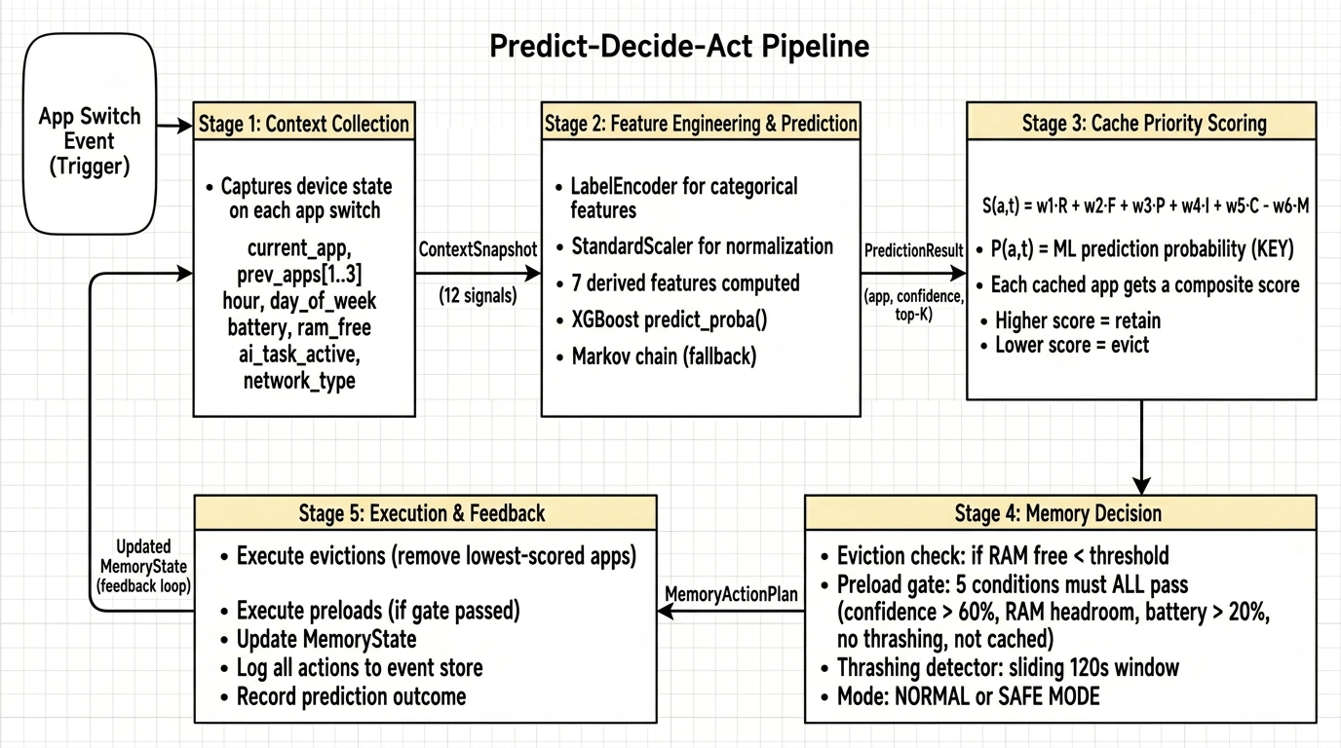
4. Proposed Methodology
Approach Overview
Step 1: On each app-switch, capture a context snapshot (app, time, battery, RAM, AI task state)
Step 2: XGBoost classifier outputs predicted next app with calibrated confidence score
Step 3: Multi-factor cache priority score computed for each resident app (including ML prediction probability)
Step 4: Under memory pressure, lowest-scored apps evicted; if confidence high enough, predicted app pre-loaded
Step 5: Thrashing detector monitors eviction-reload cycles; triggers Safe Mode if unstable
6

Slide 7
5. Mathematical Formulation
5.1 Cache Priority Score
S(a, t) = w₁·R + w₂·F + w₃·P + w₄·I + w₅·C − w₆·M
Weights: w₁=0.25, w₂=0.20, w₃=0.25, w₄=0.15, w₅=0.15, w₆=0.30
R (Recency): exponential decay based on time since last access
F (Frequency): normalized access count relative to most-used app
P (Prediction): ML model's predicted reuse probability ← KEY INNOVATION
I (Importance): static weight by app category (communication: 0.9, gaming: 0.3)
C (Context): relevance to current temporal, network, and AI-task context
M (Memory Pressure): penalty when RAM utilization exceeds 70%
5.2 Preload Decision Gate (all 5 must pass)
(1) ML confidence > 60% (2) Sufficient free RAM with headroom
(3) Battery > 20% (4) No active thrashing (5) App not already cached
5.3 Thrashing Detection
Monitors eviction-reload events in 120s sliding window; score > 0.7 → Safe Mode; < 0.3 for 60s → exit Safe Mode
7

Slide 8
6. ML Model Selection
Model Comparison
Criterion | Markov Chain (Baseline) | XGBoost (Selected) | LSTM (Rejected)
Inference latency | <1 ms | ~2 ms | ~15 ms
Context-awareness | Current app only | 19 features (full context) | 19 features
Interpretability | High (transition matrix) | High (SHAP, feature imp.) | Low (black box)
GPU required | No | No | Yes (TFLite)
Expected accuracy | 55–65% | 70–80% | 72–82%
Feature Set (12 raw + 7 derived = 19 total)
Raw: current_app, prev_app_1/2/3, hour, day_of_week, battery, is_charging, ram_free, network_type, ai_task_active, app_category
Derived: ram_utilization, is_peak_hour, is_weekend, session_depth, time_since_last_switch, battery_bucket, prev_app_category
Training: XGBClassifier, n_estimators=200, max_depth=6, 5-fold stratified CV, RandomizedSearchCV (50 iterations)
8

Slide 9
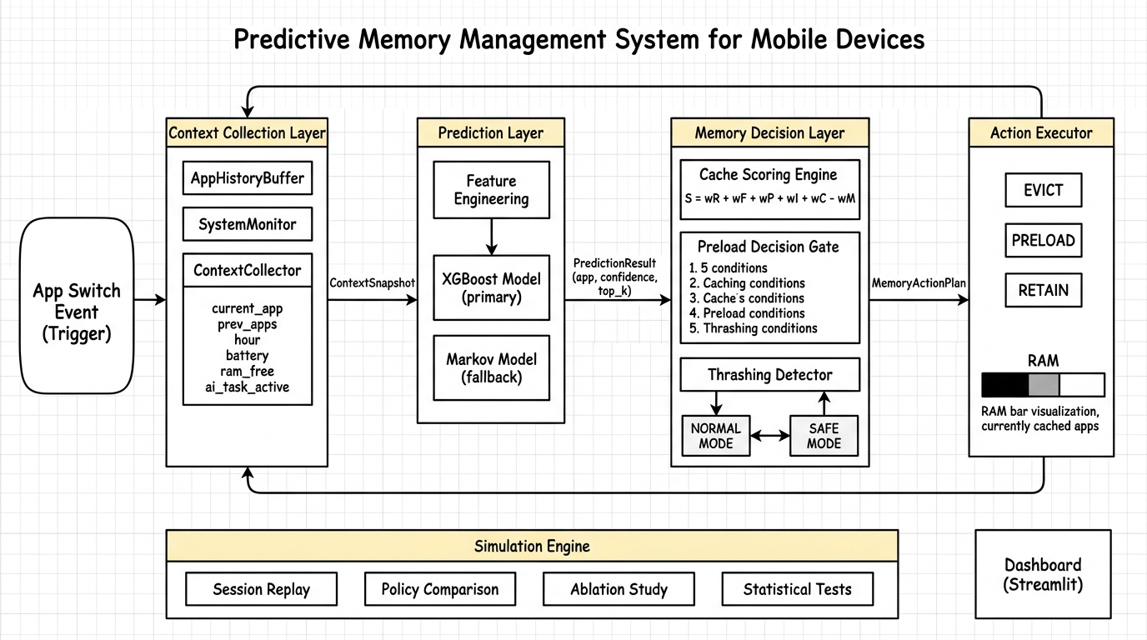
7. System Architecture (HLD)
9

Slide 10
8. Module Descriptions
Module | Purpose | Input | Output | Key Classes
1. Context Collection | Captures device state at each app switch | Raw device signals | ContextSnapshot | ContextCollector, SystemMonitor
2. Prediction | Predicts next app with calibrated confidence | ContextSnapshot | PredictionResult | FeatureEngine, XGBoostPredictor
3. Memory Decision | Scores cached apps; eviction/preload/thrashing | PredResult + MemState | MemoryActionPlan | CacheScorer, PreloadGate, ThrashDet.
4. Action Executor | Applies memory actions to device state | MemoryActionPlan | Updated MemoryState | MemoryActionExecutor
5. Simulation | Replays sessions; benchmarks policies | UserSession + Policy | BenchmarkResult | SimulationEngine, MetricsCollector
6. Dashboard | Real-time visualization of all layers | All module outputs | Interactive web UI | Streamlit, Plotly
Step | From | To | Data Object
1 | Device Event | Module 1 | App foreground transition trigger
2 | Module 1 | Module 2 | ContextSnapshot (12 signals)
3 | Module 2 | Module 3 | PredictionResult (app, confidence, top-K)
4 | Module 3 | Module 4 | MemoryActionPlan (evictions, preloads, mode)
5 | Module 4 | Module 3 | Updated MemoryState (feedback loop)
10

Slide 11
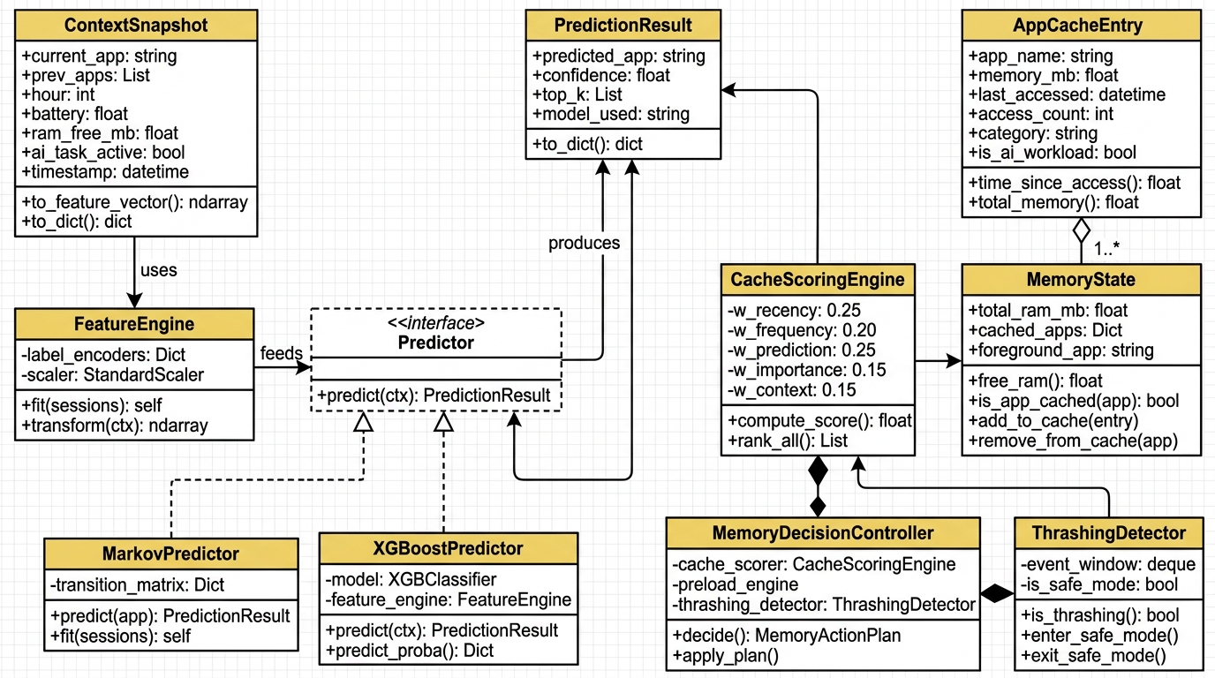
9. Class Diagram
11

Slide 12
10. Comparison with Existing Approaches
Feature | NoOpt | LRU | Android LMKD | Static Preload | Proposed
Eviction strategy | FIFO | Least recent | oom_adj + PSI | LRU + top-3 | ML-weighted scoring
Prediction-aware | No | No | No | Partial | Yes (real-time ML)
Context-aware | No | No | No | No | Yes (12+ signals)
Preload capability | No | No | No | Yes (fixed) | Yes (5-gate)
Thrashing detection | No | No | PSI (reactive) | No | Yes (proactive)
Cache hit rate | ~40% | ~55% | ~58% | ~62% | >75%
Avg latency | ~1200 ms | ~900 ms | ~850 ms | ~750 ms | <400 ms
Novelty Contributions
Prediction-Integrated Cache Scoring: ML confidence as weighted factor in eviction formula
Multi-Condition Preload Gating: 5 simultaneous conditions prevent wasteful preloading
Automatic Thrashing Degradation: self-monitoring with Safe Mode to prevent feedback loops
AI-Workload Awareness: higher eviction resistance for expensive AI model caches
12

Slide 13
11. Evaluation Plan
Parameter | Configuration
Synthetic data | 50,000 app-switch events across 5 user personas
Policies compared | NoOpt, LRU, StaticPreload, Proposed (4 policies)
RAM configurations | 4 GB, 6 GB, 8 GB
Benchmark runs | 4 × 5 × 3 × 30 = 1,800 simulations
Ablation experiments | 6 × 5 × 3 × 30 = 2,700 simulations
Statistical test | Paired t-test, p < 0.05
KPI | Definition | Target
Cache Hit Rate | % app launches from cache | >75%
Avg Launch Latency | Mean start time (ms) | <400 ms
Thrashing Events | Evict-reload cycles / session | <3
Preload Success | % preloads actually used | >60%
Prediction Accuracy | Top-1 correct prediction | >70%
13

Slide 14
12. Implementation Timeline
Week | Phase | Deliverables
1 | Foundation + Data | Project setup, app profiles, 50K synthetic events
2 | ML Models | FeatureEngine, Markov + XGBoost training & evaluation
3 | Memory Simulator | MemoryState, 3 baselines + proposed policy
4 | Benchmarking | 1,800 benchmarks + 2,700 ablation runs + statistics
5 | Visualization | Publication figures, Streamlit dashboard
6–7 | Patent Filing | Patent specification, prior art search, IPO filing
8–9 | IEEE Paper | 6-page LaTeX paper, capstone report, submission
Component | Technology | Why
Language | Python 3.10+ | Best for ML/data science
ML Framework | XGBoost, scikit-learn | Fast, no GPU, interpretable
Data | pandas, numpy | Standard data processing
Visualization | matplotlib, seaborn, plotly | Publication-quality figures
Dashboard | Streamlit | Rapid interactive web apps
Database | SQLite | Lightweight, no setup
14

Slide 15
13. References
[1] C. Shin et al., "Prediction of Mobile Application Usage Using Contextual Information," ACM UbiComp, 2012.
[2] T. Xu et al., "Predicting Mobile App Usage with Heterogeneous Graph Attention Networks," IEEE TMC, 2024.
[3] Z. Huang et al., "AppUsage2Vec: Modeling Smartphone App Usage for Prediction," IEEE ICDE, 2019.
[4] S. Zhao et al., "ContextSense: Context-Aware Mobile App Prediction via Deep Sequential Learning," ACM UbiComp, 2023.
[5] H. Pan et al., "DeepApp: Predicting Personalized Smartphone App Usage," ACM TIST, 2023.
[6] Google AOSP, "Low Memory Killer Daemon (LMKD)," AOSP Documentation, 2024.
[7] S. Lee et al., "SWAM: Revisiting Swap and OOM Killer for Mobile Devices," Samsung Research, MobiSys, 2023.
[8] Y. Chen et al., "Memory-Efficient Mobile Application Management via Predictive Caching," IEEE Access, 2024.
[9] Android Developers, "App Hibernation and Standby Buckets," Android Documentation, 2024.
[10] J. Park et al., "Learning-Based Memory Management for Mobile Devices," IEEE/ACM MICRO, 2023.
[11] T. Chen and C. Guestrin, "XGBoost: A Scalable Tree Boosting System," ACM SIGKDD, 2016.
[12] E. Ipek et al., "Self-Optimizing Memory Controllers: A RL Approach," IEEE/ACM ISCA, 2008.
[13] Z. Shi et al., "Applying Deep Learning to Data Prefetching," IEEE/ACM MICRO, 2023.
[14] M. Hashemi et al., "Learning Memory Access Patterns," ICML, 2018.
[15] J. Lin et al., "MCUNet: Tiny Deep Learning on IoT Devices," NeurIPS, 2020.
[16] S. Laskaridis et al., "Adaptive Inference through Early-Exit Networks," ACM MobiSys, 2024.
[17] Q. He et al., "On-Device LLM Inference: Memory Optimization Strategies," IEEE Edge Computing, 2025.
[18] A. Dhakal et al., "mLLM: Multi-dimensional Optimization for On-Device LLM Serving," USENIX OSDI, 2025.
Thank You
15

